Slide 1

Metabolic Complications of HIV
Dr Nomathemba Chandiwana
Principal Scientist
Ezintsha, University of the Witwatersrand, South Africa
FIDSSA Congress 2024
30 May 2024

Slide 2

Disclosure of relationships with commercial interests
Research funding: Bill & Melinda Gates Foundation, Merck, Johnson & Johnson, Novo Nordisk

Slide 3
Objectives
Review what is known about the risk of obesity and its link to metabolic complications of HIV on modern antiretroviral therapy regimens
Discuss the increased prevalence and mechanisms of metabolic disease in PLWH
Describe several key principles of risk factors, screening challenges, and management strategies of metabolic disease in PLWH

Slide 4
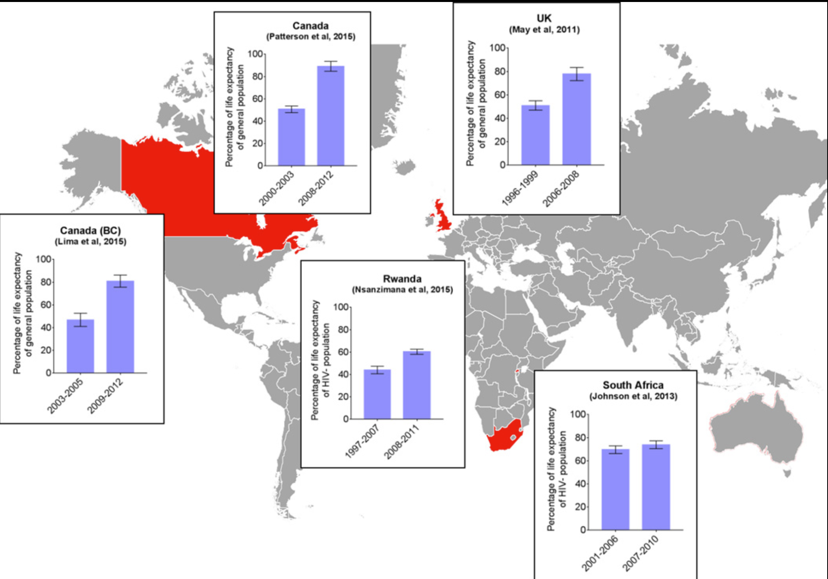
HIV and life expectancy
16 fewer years in good health
Cardiovascular disease.
Metabolic disease
Some cancers.
Osteoporosis
Kidney disease
Dementia
Source: Johnson F et al, 2016
Notes:
People living with HIV enjoy a greater life expectancy because of marked improvements in ART potency, side-effect profile, and ease of use.
Despite a near-normal lifespan, excess weight gain on newer antiretroviral regimens has been well-described in recent randomised trials and observational cohorts
Increasing attention is now being paid to chronic diseases associated attributable to both the long-term use of ART and to HIV infection itself, as well as the process of ageing seen in the general population.
The virus may never become fatal, but it can have a significant impact on your life and health. One study showed that people with HIV live 16 fewer years in good health than people who don’t have the virus.
The risk of metabolic disease including type 2 diabetes mellitus, cardiovascular disease, liver disease, and some cancers, are increased with excess adiposity
Life expectancy at age 20 years in HIV-positive individuals initiating ART, by earlier and later calendar period.

Slide 5
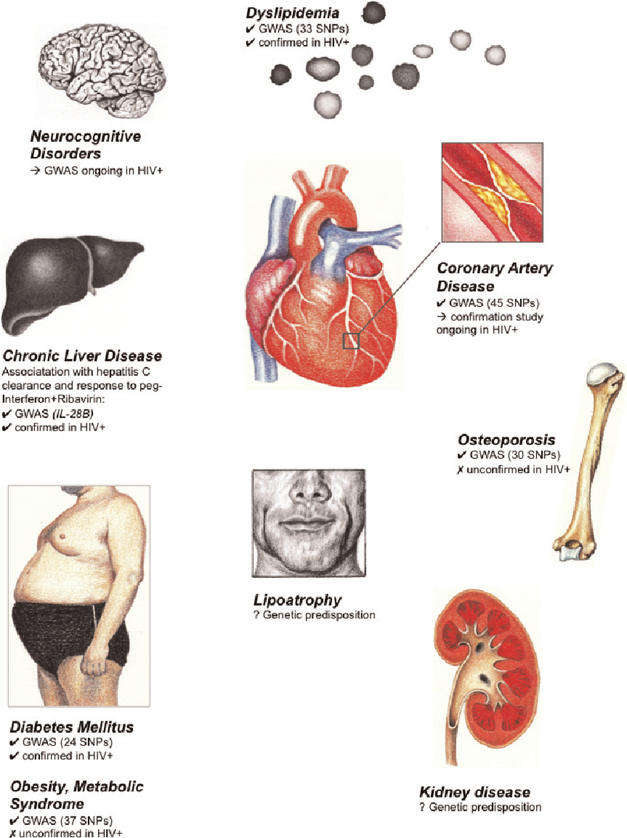
Metabolic complications of HIV
Obesity
Insulin Resistance and Type Diabetes
(NAFLD)/Metabolic-dysfunction-associated Steatotic Liver Disease (MASLD)
Dyslipidaemia
Lipodystrophy
Bone Metabolism Disorders
Hypertension
Cardiovascular Disease
Source: Tarr, 2010
Notes:
HIV can induce and accelerate cardiometabolic disease through several mechanisms, such as the gut microbial translocation. Depletion of cluster of differentiation (CD)4-positive T cells lining the gut results in leaky gut, which alters the intestinal microbiome and promotes chronic inflammation and immune activation, promoting development of atherosclerotic, cardiovascular disease (ASCVD).

Slide 6
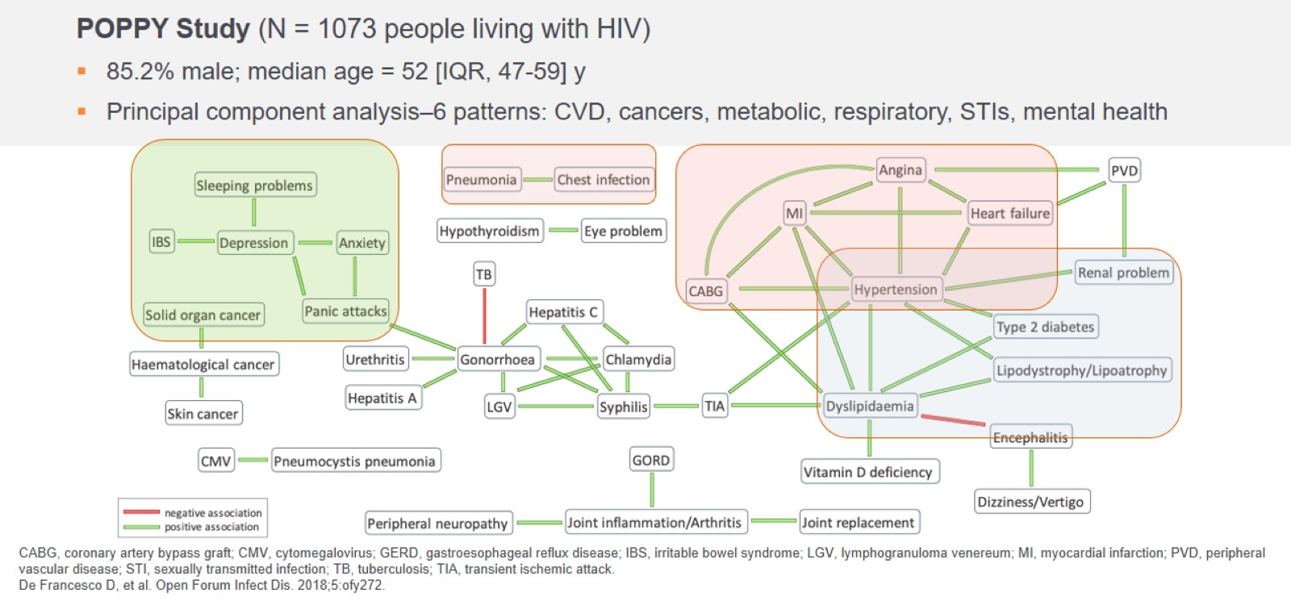
NCD in PLWH clinical phenotyping
Source: Tarr, 2010
Notes:
Data from the POPPY study indicated that comorbidities in people living with HIV tend to occur in 6 patterns, including cardiovascular diseases, sexually transmitted diseases, mental health problems, cancers, metabolic disorders, and chest/other infections.

Slide 7
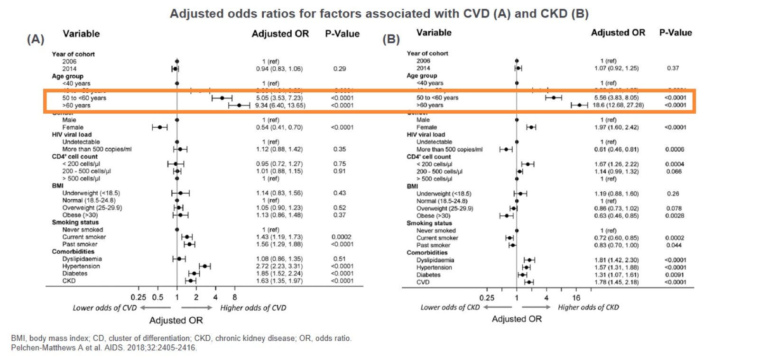
Age is the most important risk factor
Source: Tarr, 2010
Notes:
EuroSIDA study by comparing two cross-sectional cohorts from 2006 and 2014. Results showed that the 2014 cohort was older and had higher prevalence rates of hypertension, diabetes, chronic kidney disease (CKD), and cardiovascular disease (CVD) compared to 2006. Initially, the 2014 cohort had higher odds of CKD and CVD, but these associations were not significant after adjusting for age and other factors. The findings highlight the need for treatment strategies that balance HIV management with the long-term care of comorbidities..

Slide 8
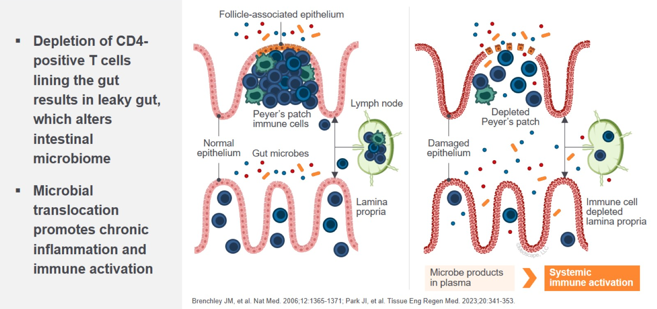
“Leaky” gut and metabolic disease
Source: Tarr, 2010
Notes:
HIV can induce and accelerate cardiometabolic disease through several mechanisms, such as the gut microbial translocation. Depletion of cluster of differentiation (CD)4-positive T cells lining the gut results in leaky gut, which alters the intestinal microbiome and promotes chronic inflammation and immune activation, promoting development of atherosclerotic, cardiovascular disease (ASCVD).

Slide 9
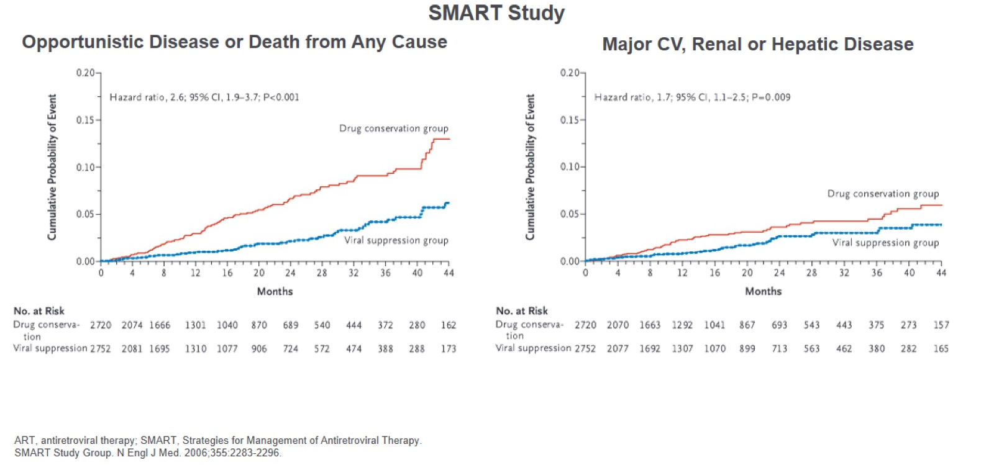
ART discontinuation increases major non-AIDS comorbidities
Source: Tarr, 2010

Slide 10
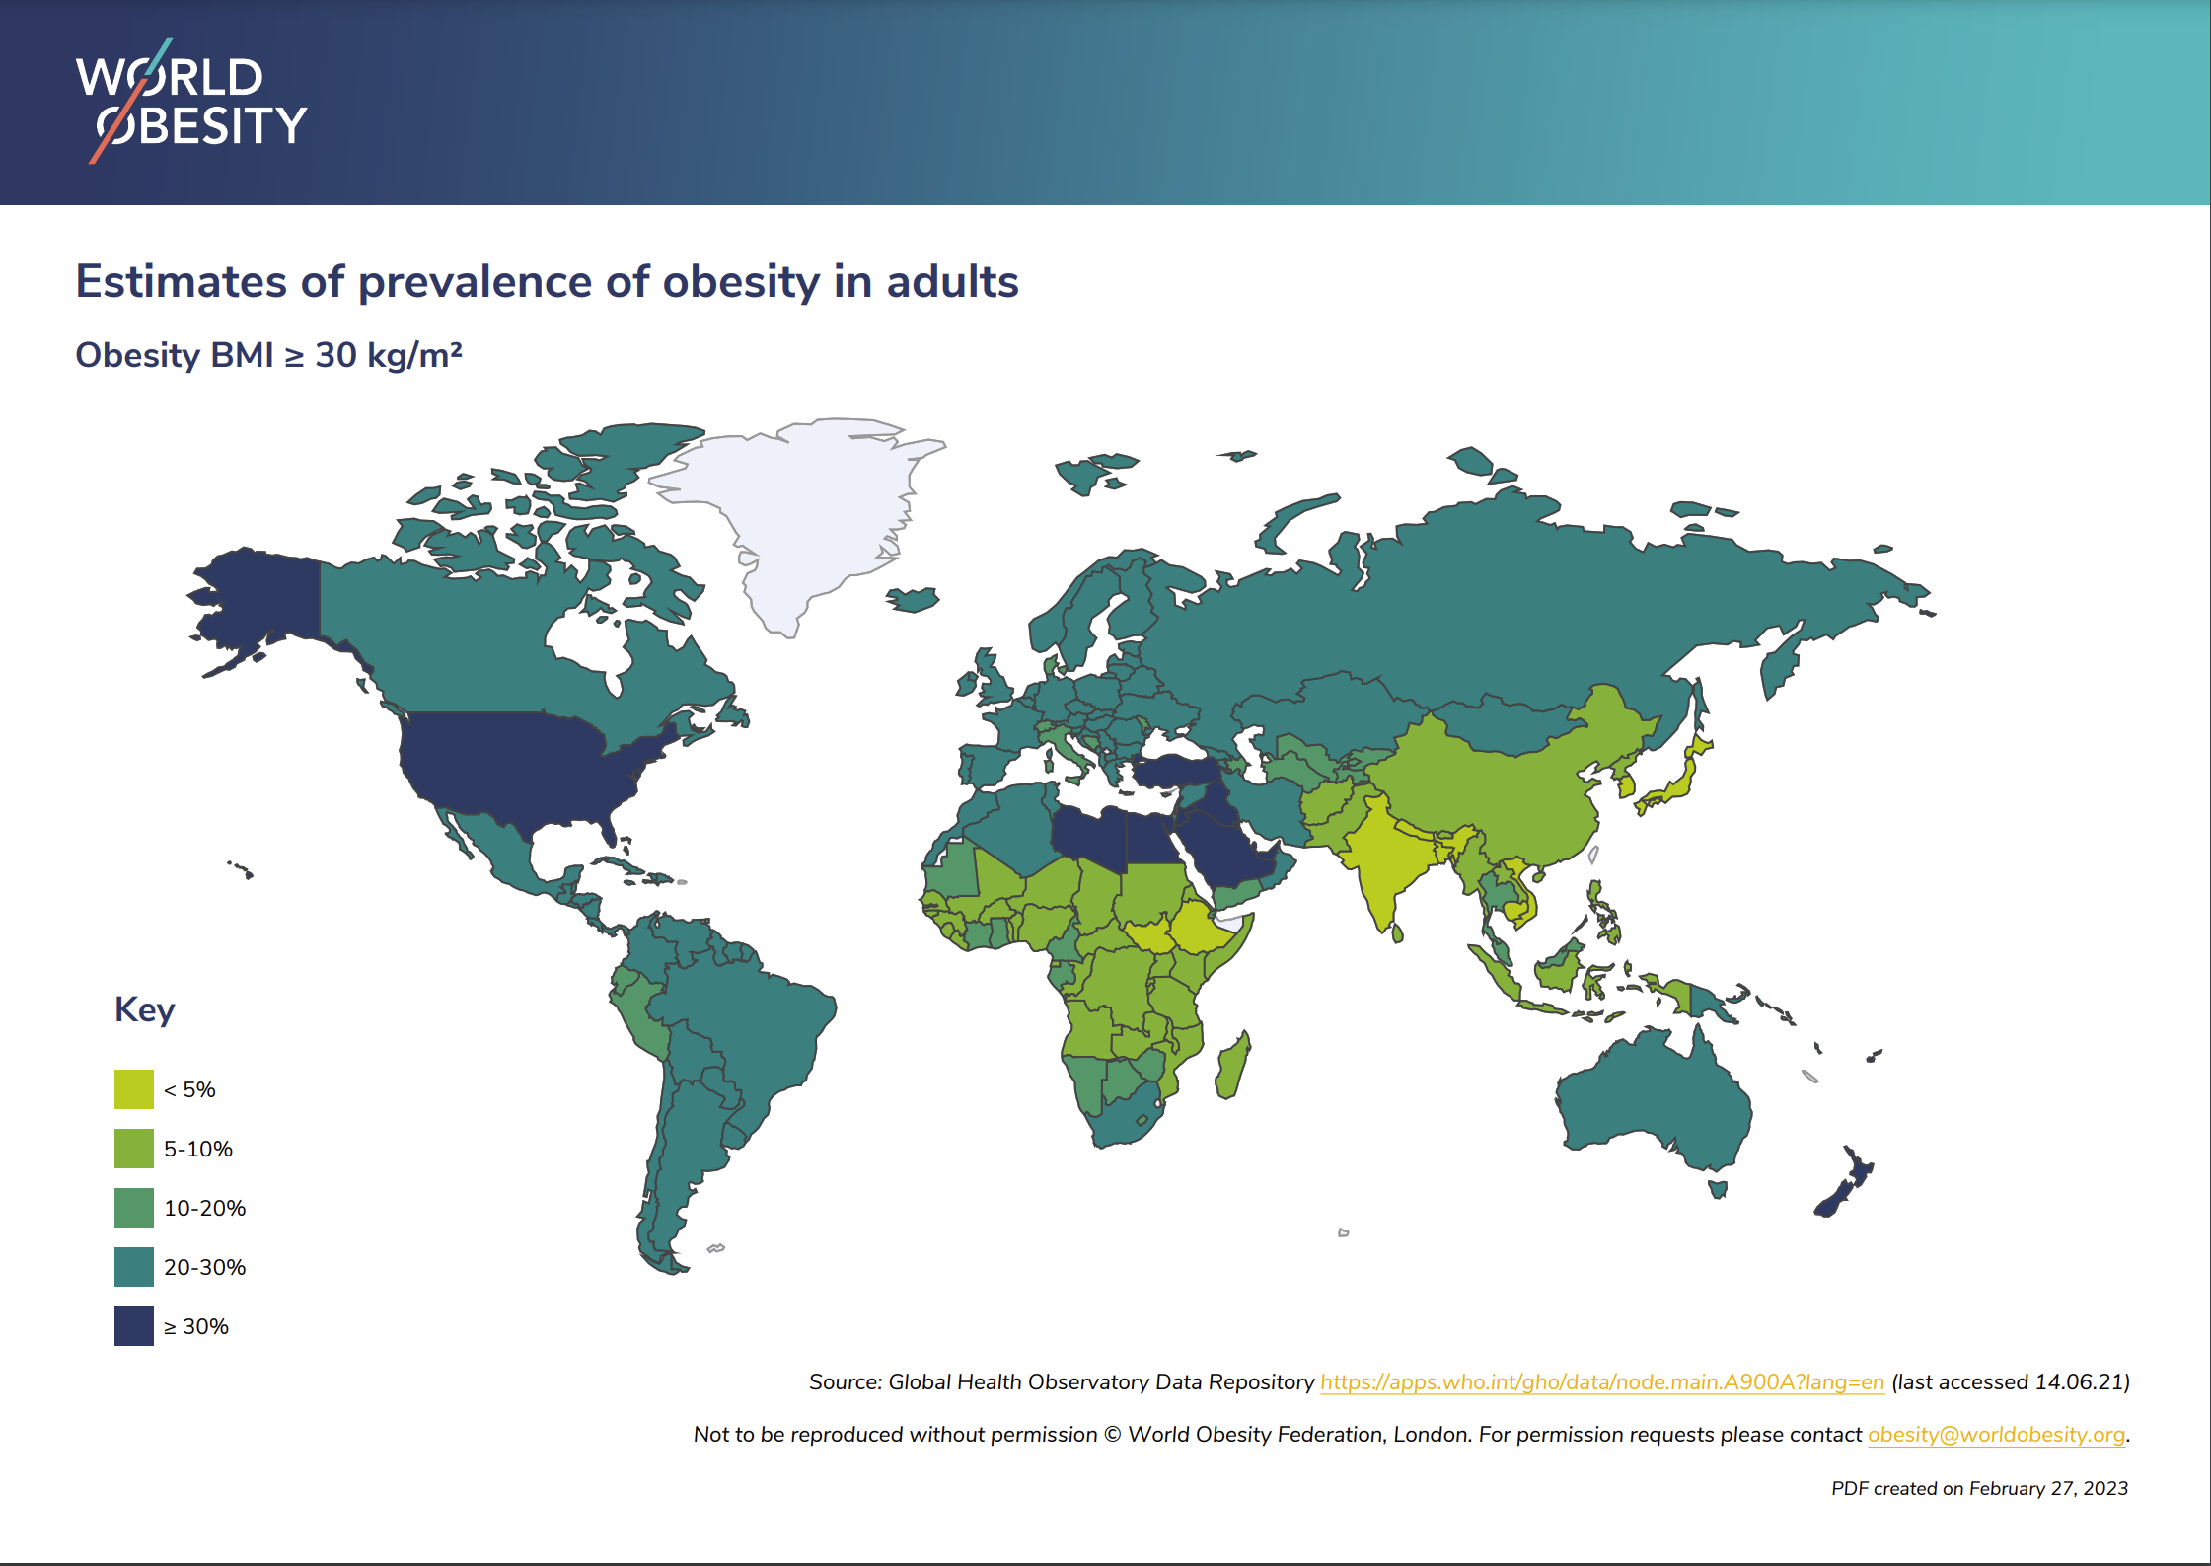
Obesity: an epidemic within the epidemic
Growing obesity epidemic in regions with high HIV prevalence
Millions of PLWH transitioned to integrase-inhibitors (INSTIs) worldwide
Specific ART regimens may exacerbate this problem
Weight gain may also lead to greater metabolic syndrome type & type 2 diabetes risk
Notes:
2 billion adults currently living overweight, of which 650 million are considered to be affected by obesity (BMI ≥30 kg/m²).
Ironically, considering the history of HIV/AIDS (initially called “slim disease” due to associated weight loss), the latest dilemma faced by many people starting HIV therapy is weight gain and obesity, particularly Black people, women, and those who commenced treatment with advanced immunodeficiency

Slide 11
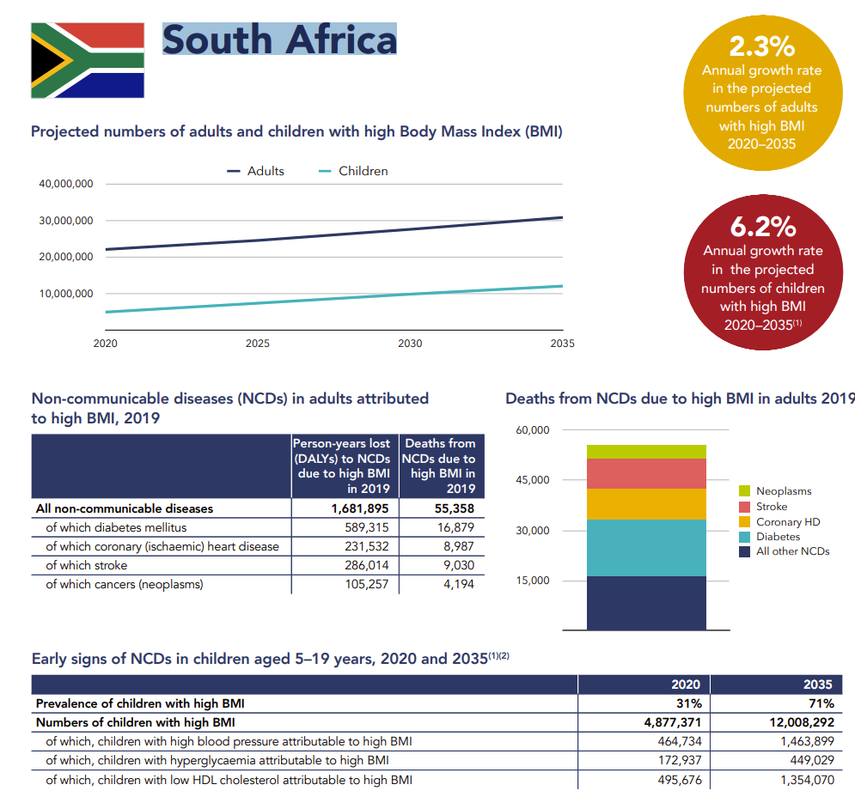
Prevalence and Projections
  2020: 31% of the population with high BMI.
  2035: Projected increase to 71%.
Children Affected by High BMI:
  2020: Approximately 4.9 million children.
  2035: Expected to rise to over 12 million.
Health Consequences
  Increases in high blood pressure, hyperglycaemia, and low HDL cholesterol due to high BMI.
Environmental and Lifestyle Factors:
  Urbanization, low physical activity, high consumption of animal proteins and sugars.
Notes:
Prevalence and Projections:
In 2020, about 31% of South Africa's population was dealing with high Body Mass Index (BMI), a key indicator of obesity. This number is projected to more than double, reaching 71% by 2035, reflecting a significant public health challenge.
The number of children with high BMI is also set to increase dramatically from approximately 4.9 million in 2020 to over 12 million by 2035.
Health Consequences:
High BMI significantly contributes to the burden of non-communicable diseases (NCDs). In 2019, a notable percentage of NCD deaths were directly attributed to high BMI, covering major health issues such as diabetes mellitus, coronary heart disease, stroke, and certain cancers.
By 2035, the early signs of NCDs attributable to high BMI, such as high blood pressure, hyperglycaemia, and low HDL cholesterol, are expected to increase substantially among children aged 5–19 years.
Environmental and Lifestyle Factors:
Factors contributing to the obesity epidemic include greenhouse gas emissions, urbanization, insufficient physical activity among adults and youth, and dietary patterns marked by high consumption of animal proteins and sugar.
Plastic waste and the annual increase in urbanization are highlighted as part of the environmental correlates of obesity.
Growth Rates:
The annual growth rate in the projected numbers of children with high BMI from 2020 to 2035 is 6.2%, whereas for adults, it's 2.3%, indicating a faster increase in obesity rates among the younger population.

Slide 12
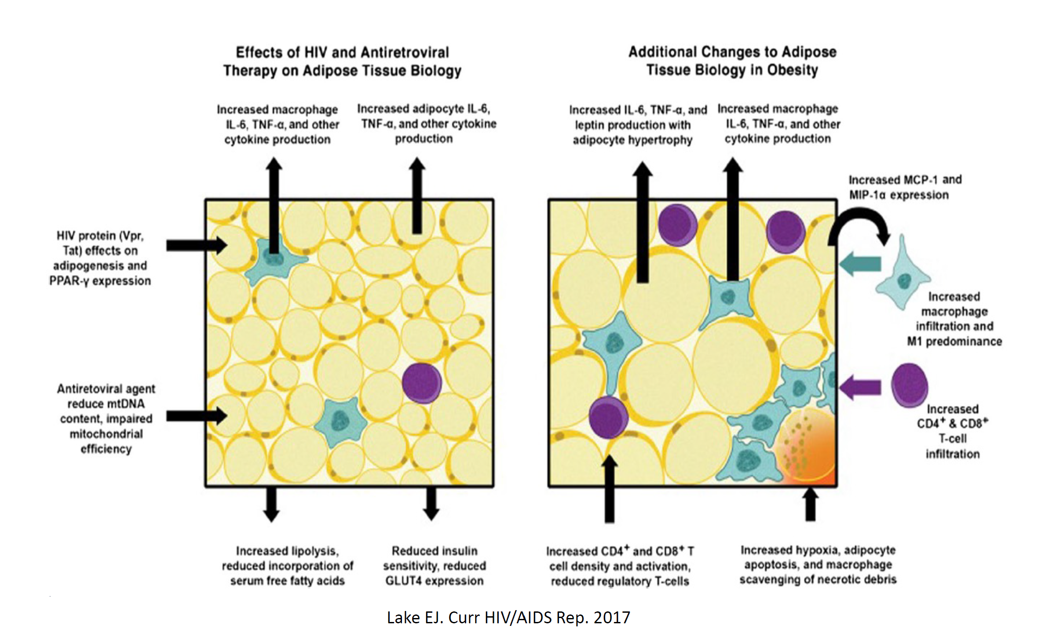
Pathophysiology of obesity
Lake EJ. Curr HIV/AIDS Rep 2017
Notes:
Early in the HIV epidemic, lipodystrophy, characterized by subcutaneous fat loss (lipoatrophy), with or without central fat accumulation (lipohypertrophy), was recognized as a frequent condition among PLWH receiving combination antiretroviral therapy.
The mechanisms of fat alterations in PLWH are complex, multifactorial, al and not fully understood, although they are known to result in part from the direct effects of HIV proteins and antiretroviral agents on adipocyte health, genetic factors, increased microbial translocation,changes in the adaptive immune milieu after infection, increased tissue inflammation and accelerated fibrosis.
Continued fat alterations in PLWH will have an important effect on lifespan, healthspan, and quality of life as patients age worldwide, highlighting the need to investigate the critical uncertainties regarding pathophysiology, risk factors, and management

Slide 13
Weight gain on all modern ART
Source: Venter, 2022
Notes:
The study by Sax et al. aimed to investigate the association between different antiretroviral therapy (ART) regimens and weight gain in people living with HIV. The study analyzed data from a large cohort of individuals who initiated ART and were followed for up to 5 years. The study found that the use of certain ART regimens, including those containing integrase inhibitors and protease inhibitors, was associated with greater weight gain compared to other regimens. The authors also observed that the magnitude of weight gain varied by sex, age, and baseline weight. The study highlights the need for careful monitoring of weight changes in people living with HIV who are on ART, especially those on regimens associated with greater weight gain, and the importance of considering the potential impact of ART on weight in the management of HIV
Here we show weight gain in ADVANCE trial up to 192 weeks. Mean weight gain was 8·9 kg [SD 7.1] in the TAF/emtricitabine+dolutegravir arm, 5·9 kg [7.1] in the TLD group, and 3.2 kg [8.1] in the TDF/emtricitabine/efavirenz group at 192 weeks and greatest among women, those on TAF, and those with lower CD4 counts at baseline. The trajectory continued but slowed after week 96.
Blood pressure remained almost unchanged. There were small changes in lipid subfractions, with minor differences by arm, and slight rises in glucose in all arms, but no HbA1c change between 96 and 192 weeks. There were few significant clinical events after 48 weeks, and no clear pregnancy outcome differences by arm.

Slide 14
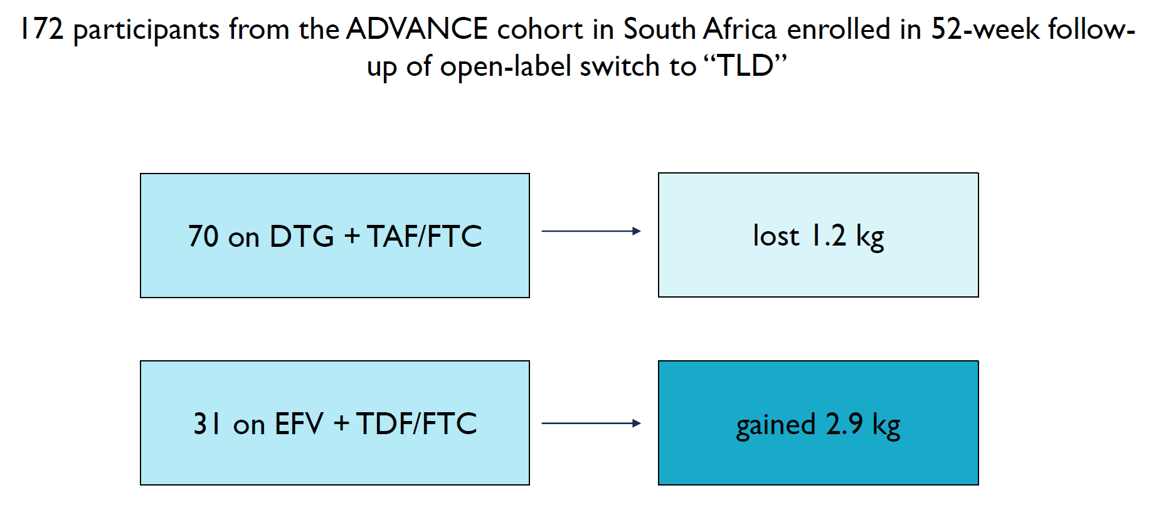
Weight gain after the switch to INSTI therapy
Source: Bosch et al, 2022
Notes:
Participants switching from TAF/FTC + DTG to TDF/3TC/DTG after week 192 also showed significant reductions in lipids, glucose, blood pressure, and HbA1C, while participants switching from TDF/FTC/EFV to TDF/3TC/DTG showed significant decreases in lipids and HbA1C.

Slide 15
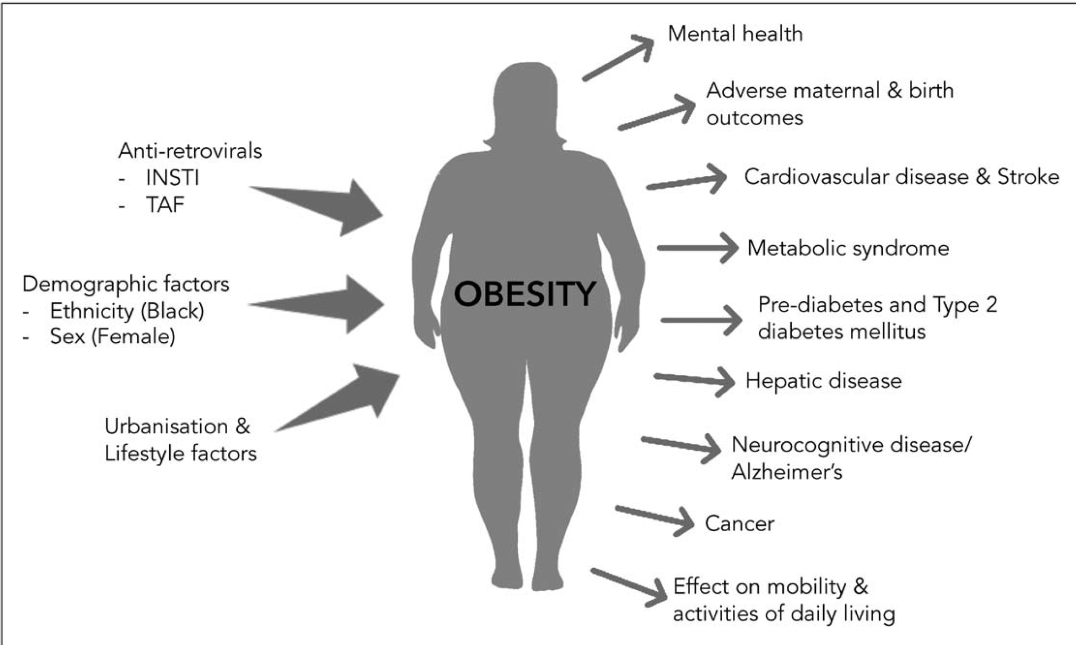
Drivers and consequences of obesity in PLWH
Source: Shah & Hill 2021
Notes:
Historically, HIV associated-wasting or lipodystrophy (changes in fat distribution) were expected side effects of HIV disease progression and earlier ART drugs such as nucleoside reverse transcriptase inhibitors (NRTIs) and first-generation protease inhibitors
Weight gain during the first year after ART initiation has been associated with lower mortality in underweight and normal-weight patients, but not in overweight or obese patients
Over 230 diseases- If you treat the obesity you delete chronic disease from people
Excess weight gain during HIV treatment to increased risk for diabetes, cardiovascular disease, hepatic steatosis, and liver fibrosis
Rise in weight in PWH is complex, likely multifactorial, caused by the interactions between the modern obesogenic environment, HIV metabolic immune response, antiretroviral regimen composition, and demographic factors.

Slide 16
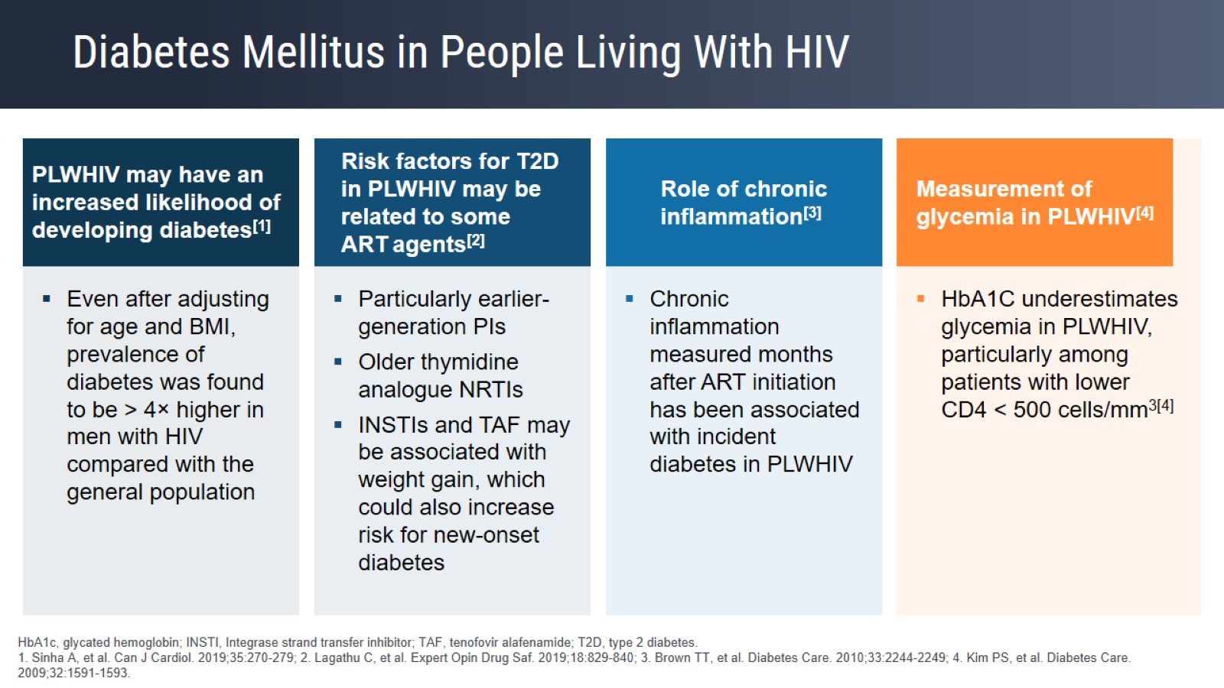
Obesity & type 2 diabetes growing health threats for PLWH globally
Millions of PLWH now transitioned to “modern ART” (DTG, TAF, etc.)
Obesity epidemic has high overlap with HIV epidemic, including in South Africa
Weight gain places PLWH at higher risk of T2DM?
Source: Venter et al, NEJM 2019
Notes:
People living with HIV have an increased likelihood of developing diabetes: the increased prevalence of metabolic disease could be partly related to antiretroviral agents, such as some protease inhibitors, first-generation nucleoside reverse transcriptase inhibitors, and use of some integrase inhibitors. In the REPRIEVE trial, an increased incidence of diabetes was seen in patients treated with statin therapy (incidence rate ratio = 1.35); this increase was consistent vs other statin trials and not significantly above rates shown in the general population. There was no apparent treatment effect on glucose levels.

Slide 17
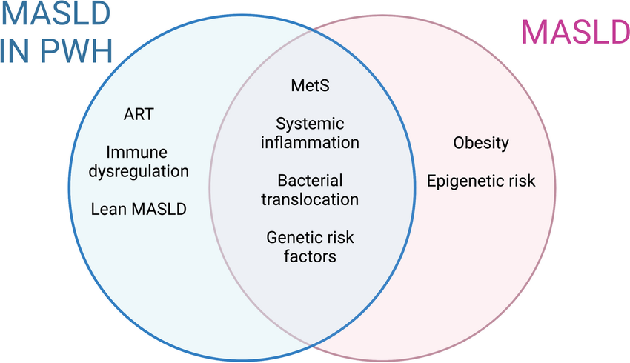
Metabolic dysfunction-associated steatotic liver disease (MASLD),
MASLD affects 30% of adults globally
MASLD includes SLD to MASH cirrhosis
Independent risk factor for CVD, type 2 diabetes, and all-cause mortality.
MASLD is the least recognized component of MS, particularly in Africa,
Bialy, 2024
Notes:
Global Prevalence: Metabolic dysfunction-associated steatotic liver disease (MASLD) affects 30% of adults worldwide, with a significant rise over the past two decades, paralleling the global increase in obesity.
Middle-Income Countries: Countries like South Africa are particularly affected due to the surge in obesity rates.
Disease Spectrum: MASLD includes a range of liver conditions from simple steatosis (steatotic liver disease, SLD) to more severe forms like metabolic dysfunction-associated steatohepatitis (MASH), cirrhosis, and liver cancer.
Health Risks and Consequences
Cardiovascular and Metabolic Risks: MASLD is an independent risk factor for cardiovascular disease, type 2 diabetes, and all-cause mortality.
Liver Transplantation: MASH cirrhosis is a leading indication for liver transplants.
Under-recognition: Despite its significant impact, MASLD is the least recognized component of metabolic syndrome, particularly in Africa, where its prevalence is estimated at 13.5%.

Slide 18
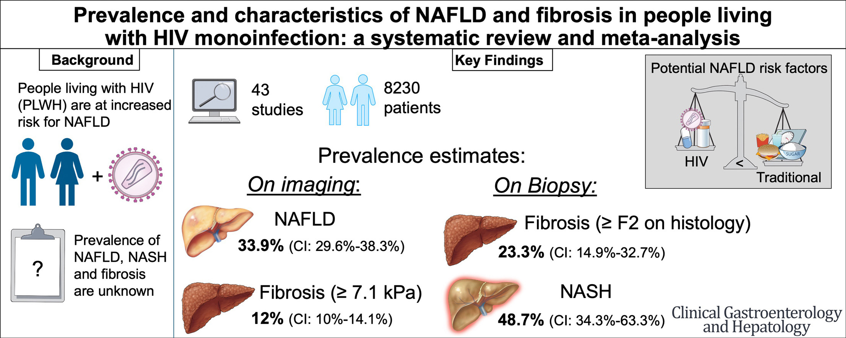
MASLD in PLWH
Notes:
Non-HIV Related Death: Chronic liver disease is the second leading cause of non-HIV related deaths among PWH.
Prevalence and Predictors: The prevalence and predictors of MASLD in PWH are not well understood.
Contributing Factors: Factors such as immune activation, altered adipose tissue function, and certain antiretroviral drugs contribute to inflammation, insulin resistance, and metabolic disturbances, exacerbating liver health issues.
Scarcity of Data: Despite high rates of HIV and obesity in Africa, particularly South Africa, comprehensive data on MASLD among PWH is limited.

Slide 19
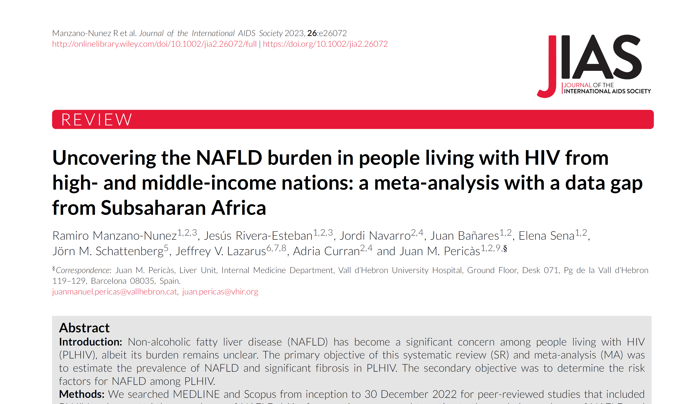
Notes:
A 2023 meta-analysis of 6,326 PWH from 24 studies conducted between 2009 and 2022, the pooled prevalence of NAFLD (previous nomenclature for MASLD) in all PWH was 38% overall and 34% in middle-income countries, with substantially greater risk among those with comorbid obesity⁶. However, a major gap in this evidence base is the lack of data on the risks of MASLD in Black African PWH, for whom no dedicated studies were available

Slide 20
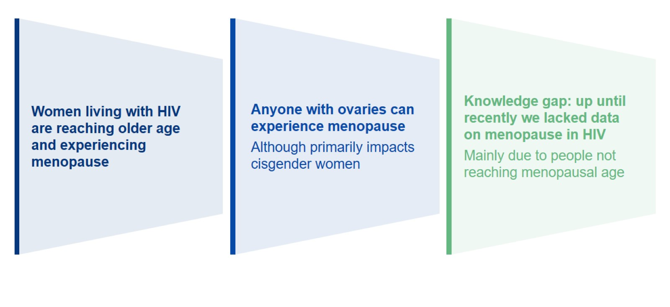
Menopause and HIV
Notes:
Non-HIV Related Death: Chronic liver disease is the second leading cause of non-HIV related deaths among PWH.
Prevalence and Predictors: The prevalence and predictors of MASLD in PWH are not well understood.
Contributing Factors: Factors such as immune activation, altered adipose tissue function, and certain antiretroviral drugs contribute to inflammation, insulin resistance, and metabolic disturbances, exacerbating liver health issues.
Scarcity of Data: Despite high rates of HIV and obesity in Africa, particularly South Africa, comprehensive data on MASLD among PWH is limited.

Slide 21
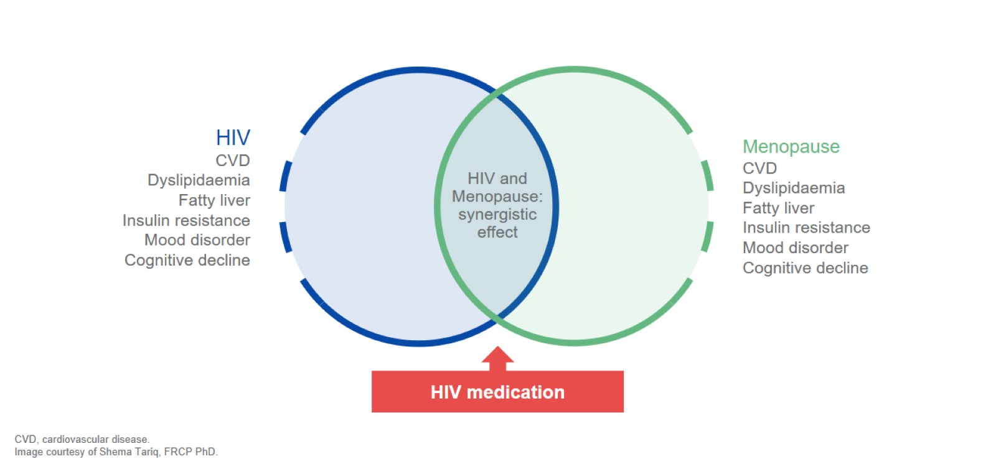
Menopause the cardiometabolic transition
Notes:
Menopause marks a significant turning point for women's health, with notable cardiometabolic changes occurring during this transition. Research indicates that menopause, combined with aging, heightens the risk of cardiovascular disease (CVD). Key changes during the menopausal transition include:
Increased Fat Mass: Predominantly in the truncal region.
Insulin Resistance: Higher likelihood of developing insulin resistance.
Dyslipidemia: Abnormal lipid levels.
Endothelial Dysfunction: Impaired vascular function.
Loss of Estrogen Protection: Endogenous estrogen protects against CVD during reproductive years. This protection diminishes around ten years post-menopause, particularly affecting women with vasomotor symptoms.
Cardiovascular Risk Factors: Early management of traditional CVD risk factors (hypertension, obesity, diabetes, dyslipidemia, smoking) is crucial. Additionally, women's reproductive history should be considered, as conditions like gestational hypertension/diabetes, premature ovarian insufficiency, and functional hypothalamic amenorrhea can increase CVD risk during and after menopause.

Slide 22

Helpful resources
Notes:
Menopause marks a significant turning point for women's health, with notable cardiometabolic changes occurring during this transition. Research indicates that menopause, combined with aging, heightens the risk of cardiovascular disease (CVD). Key changes during the menopausal transition include:
Increased Fat Mass: Predominantly in the truncal region.
Insulin Resistance: Higher likelihood of developing insulin resistance.
Dyslipidemia: Abnormal lipid levels.
Endothelial Dysfunction: Impaired vascular function.
Loss of Estrogen Protection: Endogenous estrogen protects against CVD during reproductive years. This protection diminishes around ten years post-menopause, particularly affecting women with vasomotor symptoms.
Cardiovascular Risk Factors: Early management of traditional CVD risk factors (hypertension, obesity, diabetes, dyslipidemia, smoking) is crucial. Additionally, women's reproductive history should be considered, as conditions like gestational hypertension/diabetes, premature ovarian insufficiency, and functional hypothalamic amenorrhea can increase CVD risk during and after menopause.

Slide 23
Possible strategies to address metabolic disease in PLWH
Switch ART Regimens
Lifestyle interventions
Public health interventions
Medical therapies & surgical intervention

Slide 24
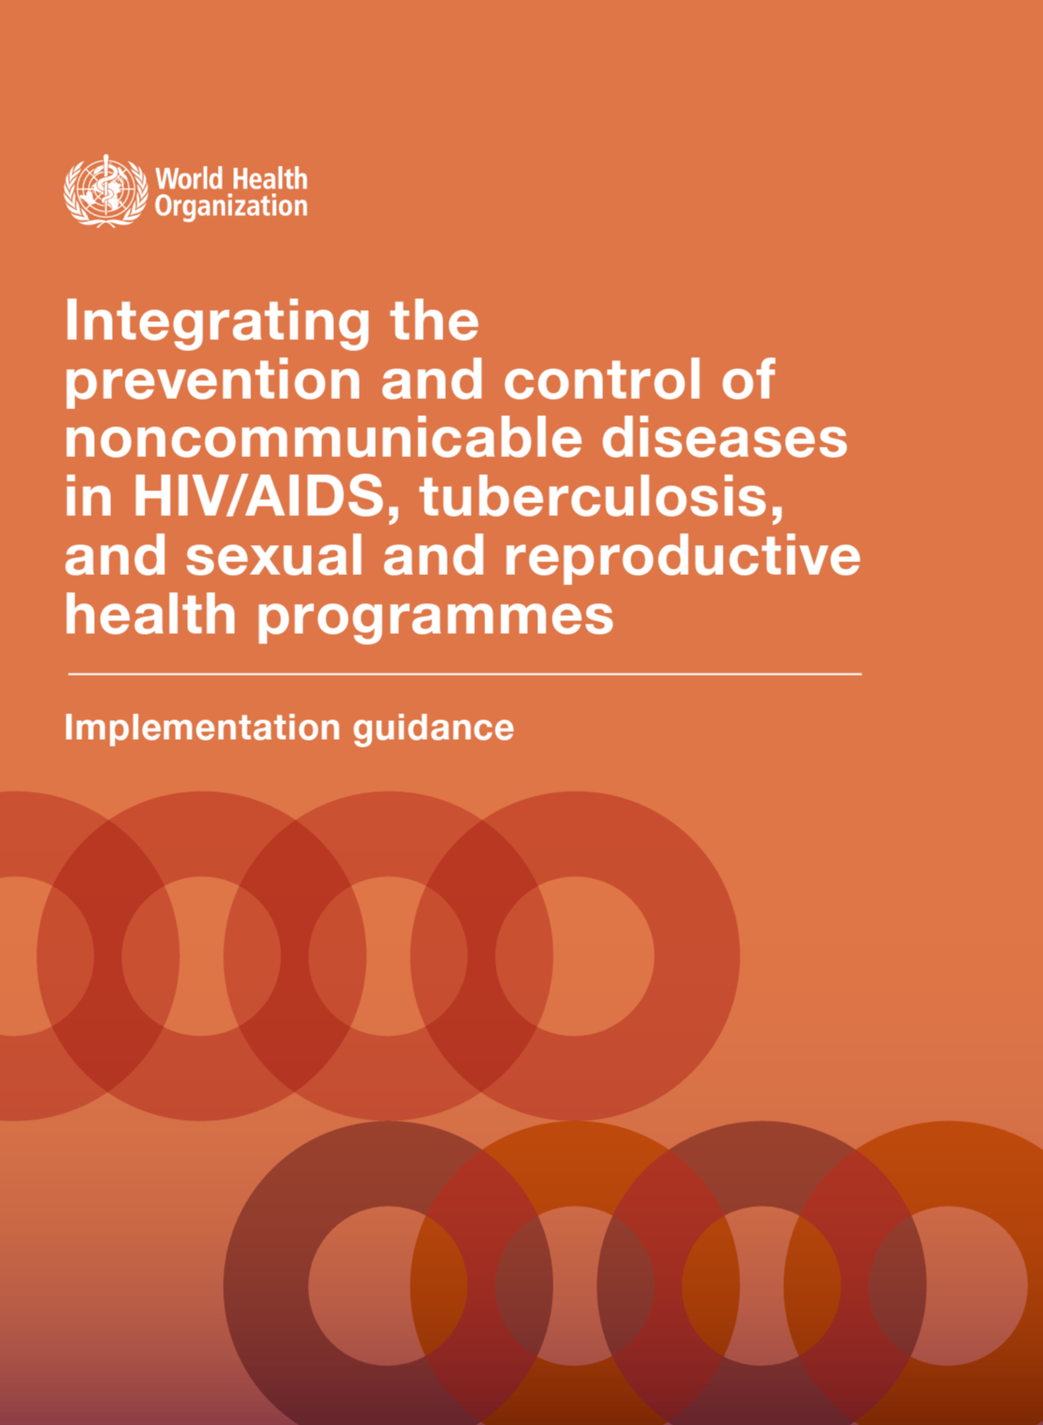
Public health interventions
Education and awareness campaigns
Improving access to healthy food
Physical activity promotion
Policy changes
Community-based interventions
Notes:
Education and awareness campaigns: Public health agencies can launch campaigns to raise awareness about the risks of obesity and promote healthy lifestyle habits such as healthy eating, regular physical activity, and reducing sedentary behaviors.
Improving access to healthy food: Many communities lack access to affordable and healthy food options, especially in lower-income areas. Public health interventions can include initiatives that increase access to fresh fruits and vegetables, promote healthy eating habits, and support local farmers' markets.
Physical activity promotion: Encouraging people to increase their physical activity levels can also be an effective public health intervention for combating obesity. Programs that promote walking, cycling, and other forms of exercise can be implemented in schools, workplaces, and communities.
Policy changes: Public health interventions can include policy changes that promote healthy behaviors, such as implementing taxes on sugary drinks and unhealthy foods, restricting marketing of unhealthy foods to children, and improving the nutritional quality of school meals.
Community-based interventions: Public health interventions that involve community-based approaches, such as community gardens, walking clubs, and support groups, can promote healthy lifestyles and create a sense of community.
These are just a few examples of the public health interventions that can be used to combat obesity. A comprehensive approach that includes education, policy changes, and community-based interventions can be an effective way to address this complex issue.

Slide 25

Will these strategies work for PLWH?

Slide 26
Will these strategies work for PLWH?

Slide 27
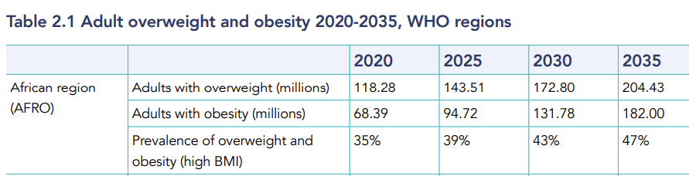
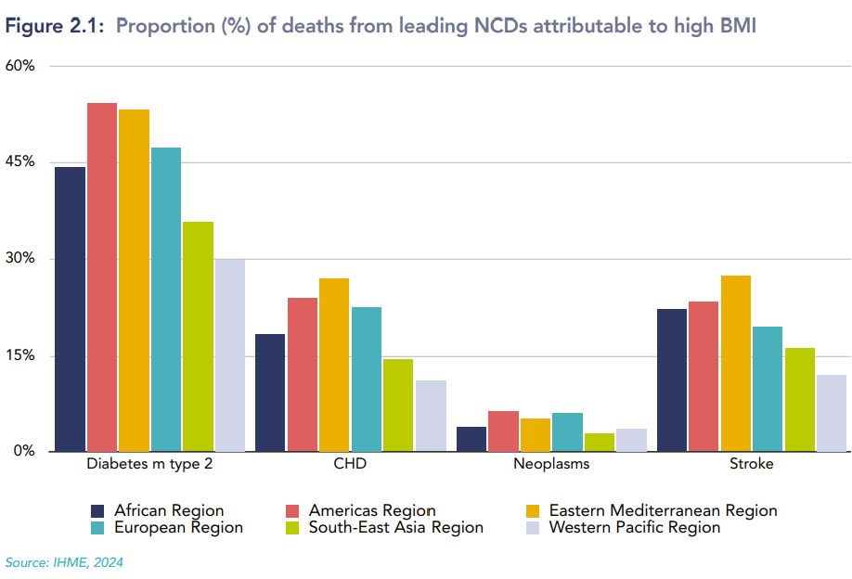
Cost of inaction
Notes:
This rising tide of obesity and its associated health complications is intricately linked to economic development, with countries experiencing rapid economic growth also seeing swift increases in the prevalence of overweight individuals, further compounded by environmental challenges such as urbanization and changes in dietary and activity patterns.

Slide 28
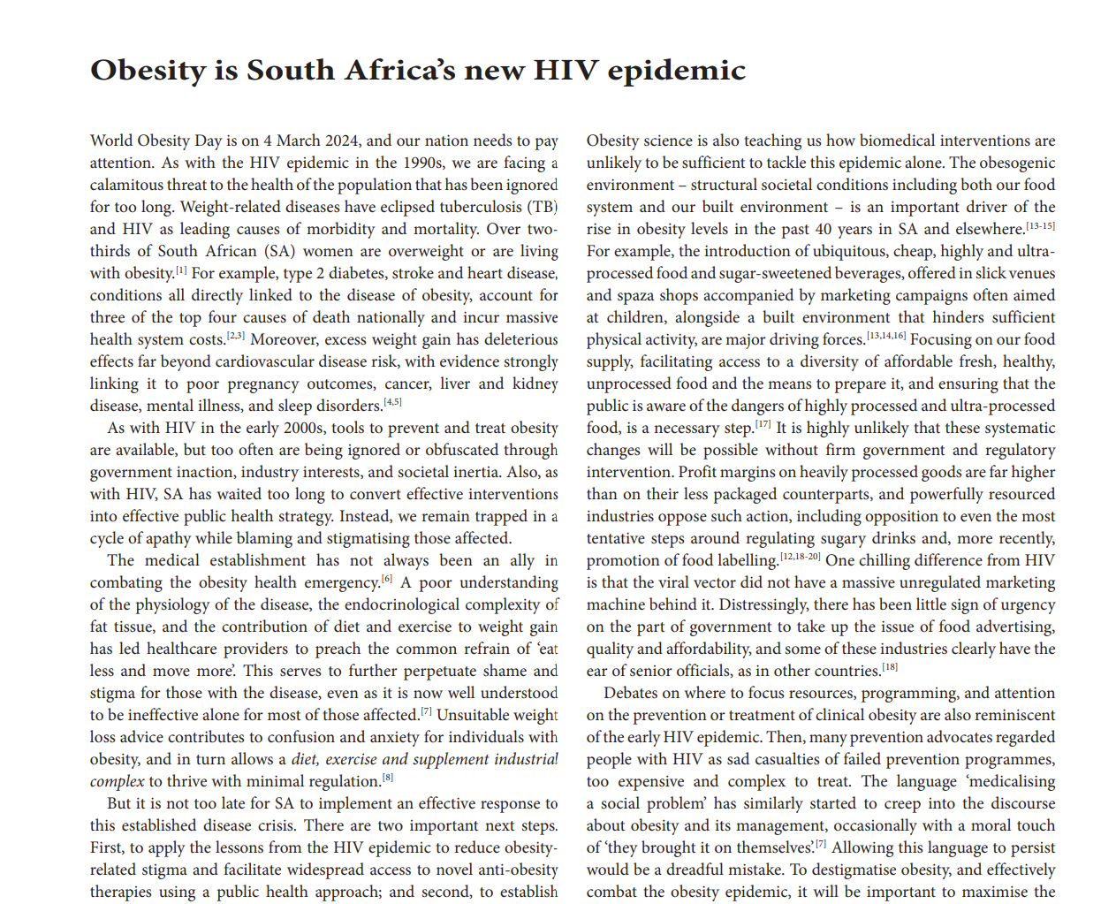
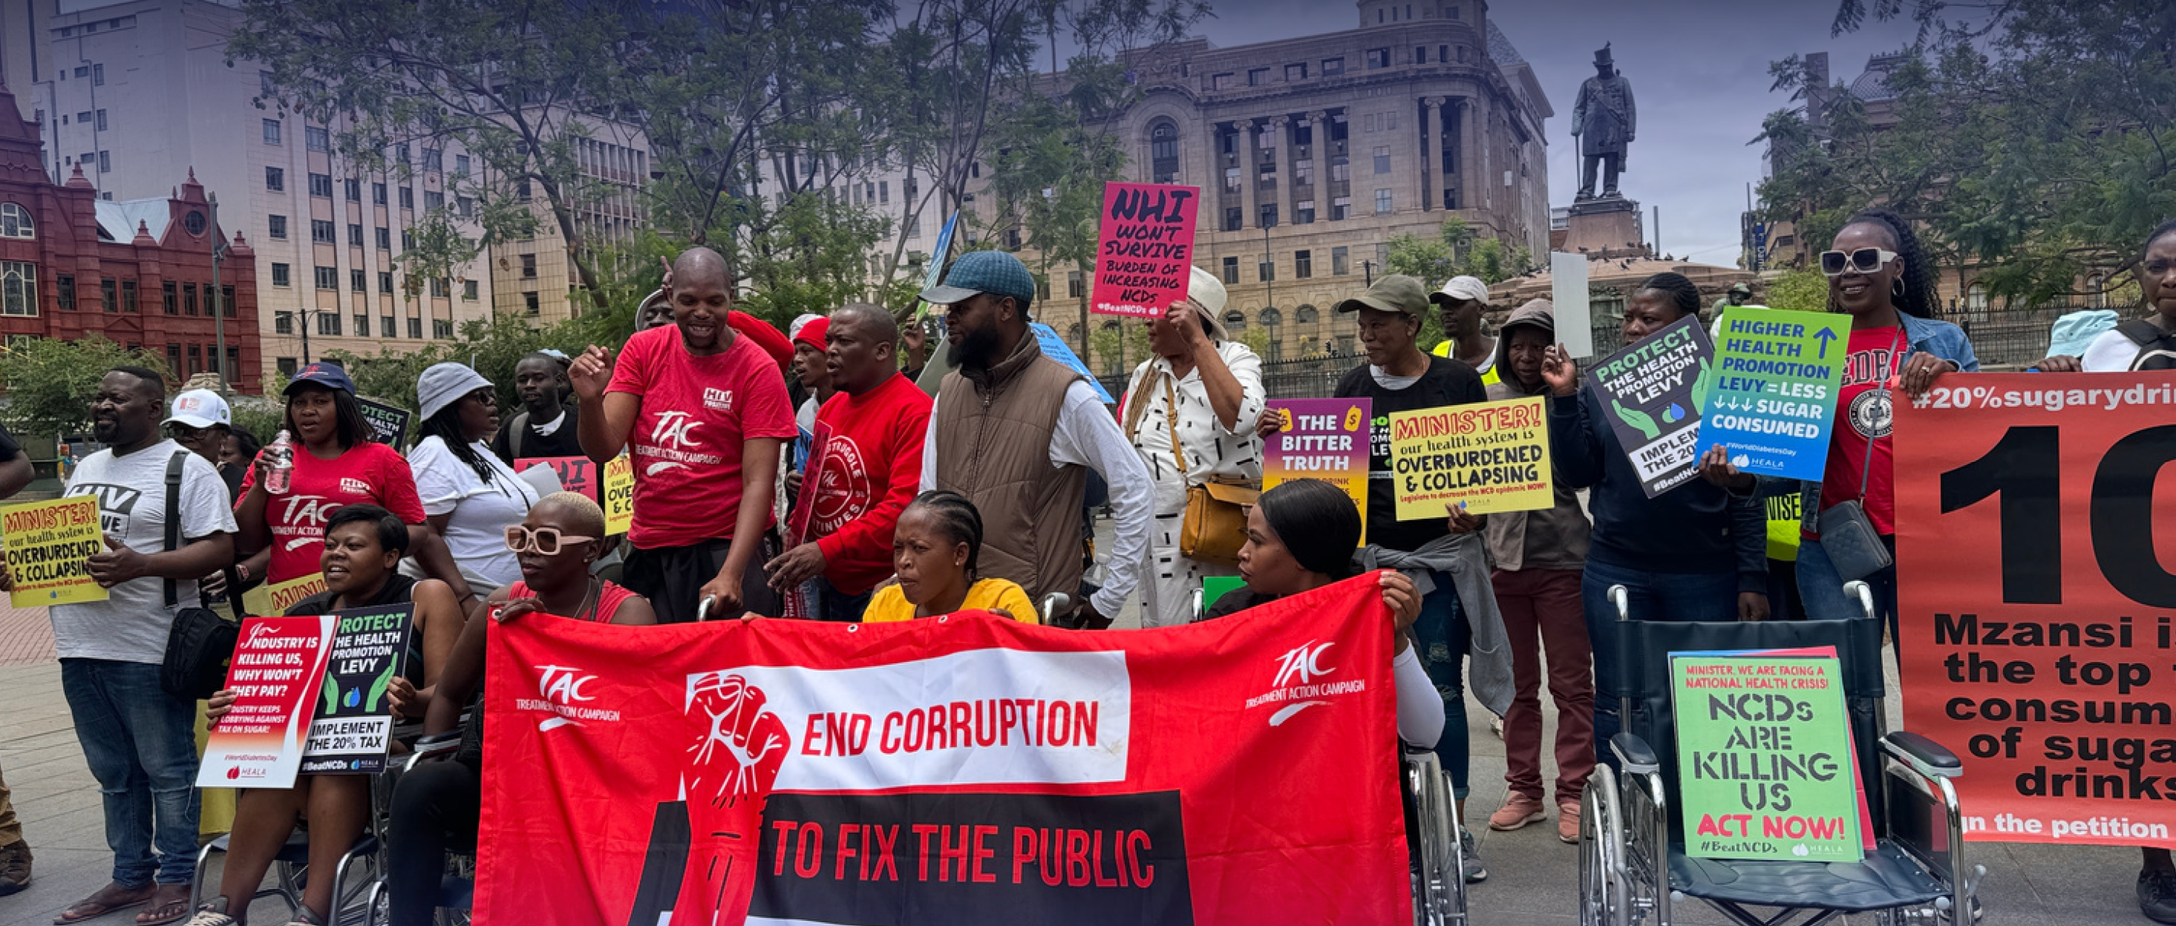


Lessons learnt from the HIV epidemic
Notes:
Drawing lessons from South Africa's HIV epidemic, there is a blueprint for tackling obesity through destigmatization, education, and access to treatment. However, overcoming the challenges posed by obesity requires addressing the root causes: an obesogenic environment marked by the availability of cheap, highly processed foods and a lifestyle that discourages physical activity. Regulatory reforms, public health initiatives, and access to innovative medical treatments are essential components of a comprehensive strategy.

Slide 29
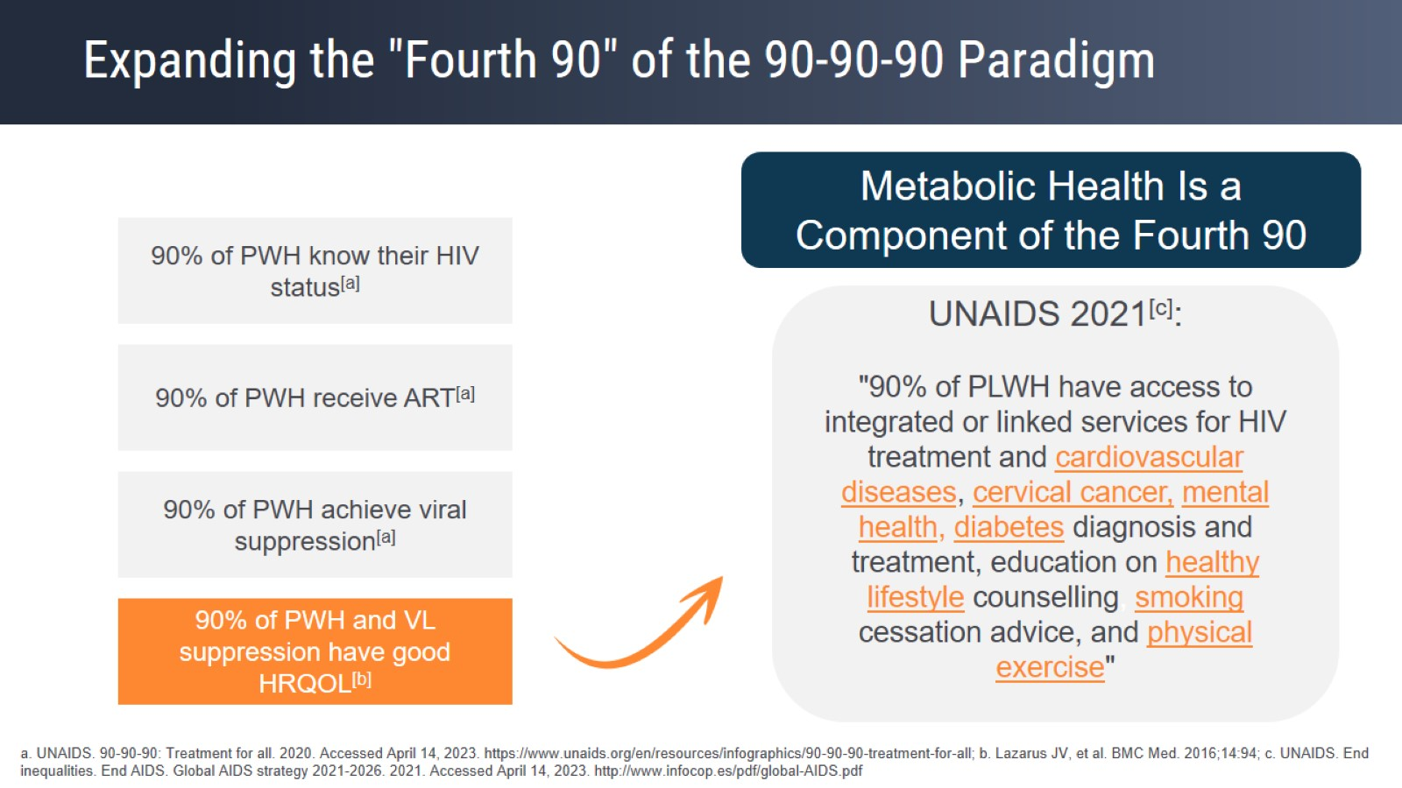
Metabolic health is HIV management

Slide 30
Take-aways
PLWH on modern ART regimens are at risk of ART-emergent weight gain and metabolic disease
Our understanding of the trajectory of cardiometabolic complications is sorely lacking.
Several strategies to reduce these risks are being trialed in PLWH currently, including changing ART regimens and testing novel medical therapies for obesity
Longitudinal studies of prevalence, incidence, and pathogenesis are needed
Culturally appropriate, affordable and scalable interventions are urgently needed

Slide 31
Thank you to my [awesome] mentors/collaborators:
Jennifer Manne-Goehler
Francois Venter
Mark Siedner
Sylvia Kehlenbrink

Slide 32
